Slide 1
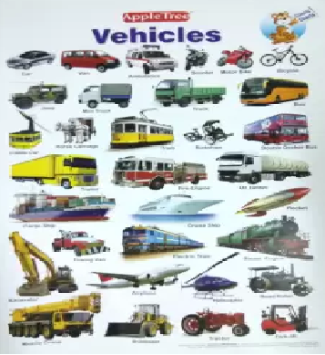
Coal and Petroleum

Slide 2
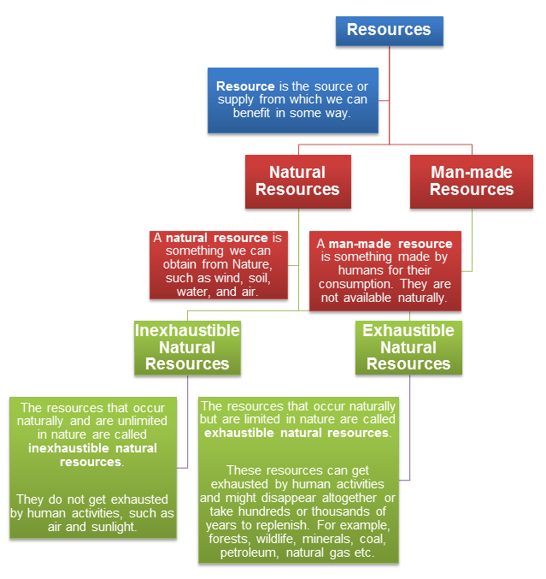

Slide 3
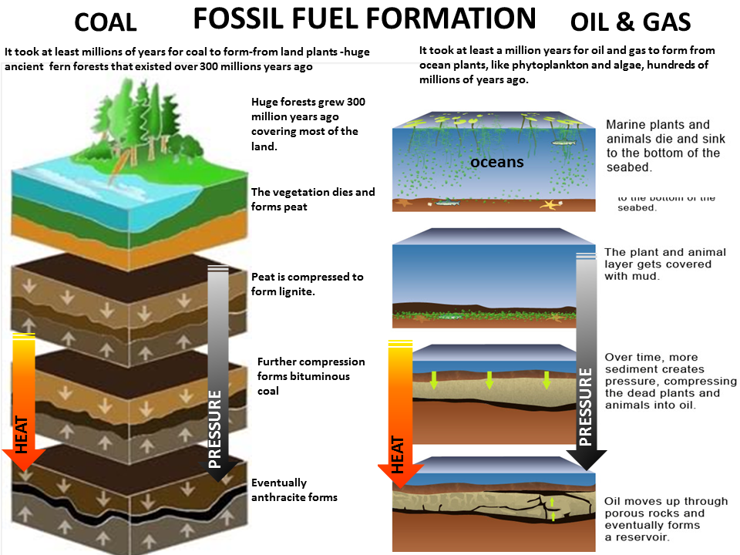

Slide 4
What are fuels?
A fuel is any substance that releases large amounts of energy in the form of heat and light when it is burned. For example, coal and petroleum are fuels.
Coal, Petroleum and Natural Gas are exhaustible natural resources. They are fossil fuels.
Fossil fuels are fuels that are formed by fossils (or dead remains) of living organisms.

Slide 5
Solid Fuels
These fuels exist in a solid state at room temperature
For example, coal, firewood, animal dung cakes, charcoal, coke

Slide 6
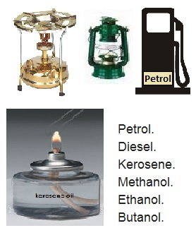
Liquid Fuels
These are volatile liquids that produce vapour which burns and produces energy
For example, petrol, diesel,
kerosene

Slide 7
Gaseous Fuels
These are the fuels that exist in the form of a gas or as a mixture of different gaseous fuels.
For example, natural gas, biogas, CNG, coal gas

Slide 8
Why do we need fossil fuels?
Transportation: fuels are used to run different vehicles such as cars, trucks, motorcycles, trains, airplanes etc.
Cooking: fuels are needed for cooking. For instance, LPG is used in urban areas while firewood, coal and cattle dung is used in rural areas.
Heating: fuel is also used to generate heat
Electricity production: different fuels such as coal, petrol, natural gas and diesel are used to generate electricity in power plants
Industrial usage: many industries use fuels for different purposes such as producing electricity, running their machinery and heating
Rockets and other space vehicles: fuels called propellants are used in rockets that help in launching the space vehicles

Slide 9
Characteristics of a good fuel
The characteristics of good fuel are:
It should be economical.
It should be available easily
It should not emit poisonous gases on burning
It should produce large amounts of heat with respect to its mass (it should have a high calorific value)
It should be easy to transport and handle
It should not produce a bad odour
It should be clean and should not produce many ashes
It should not ignite easily at room temperature

